Slide 1

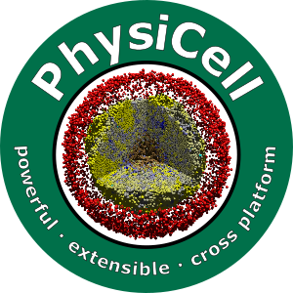

Setting up MacOS for PhysiCell
Slides, videos, links and more:
https://github.com/physicell-training/ws2021
Randy Heiland and John Metzcar
@PhysiCell
July 25, 2021

Slide 2
Overview
Apple Intel CPU vs. Silicon (M1) CPU
You may experience some problems with our setup instructions if you have the newer Apple Silicon CPU. If so, please contact us (see Support page at end).
OpenMP-enabled g++ (using Homebrew)
Test building the default model (“heterogeneity”)
Python 3 (using Anaconda distribution)
Test building an intracellular model
ImageMagick
PhysiCell Model Builder
*At the end of the slides, we includes notes on other useful software including COPASI. COPASI is required for the 2021 PhysiCell workshop – so make it through to the end!!!!
Minimal setup
Traditional* setup

Slide 3
Brief note on this presentation
We tried to make all the Terminal commands bold face and able to be directly copied (command + c) and pasted (command + v) directly into the Terminal
Note that this is a static document – it is possible that the commands could vary slightly as version numbers change, particularly for the PhysiCell Model Builder, which is in beta release.

Slide 4
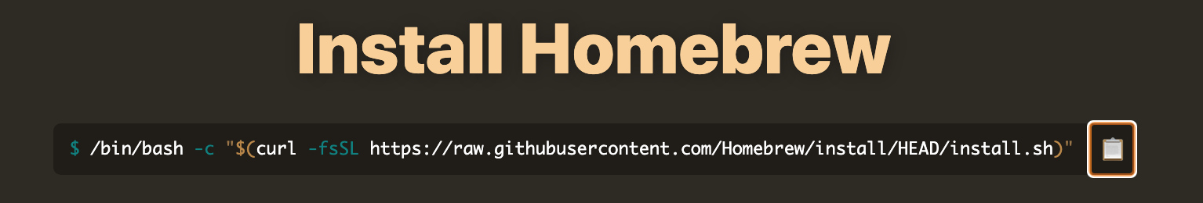
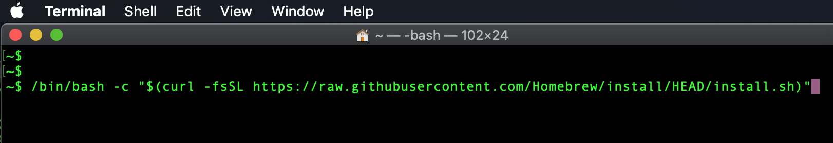
OpenMP-enabled g++
The default /usr/bin/g++ (clang) that comes with macOS is not OpenMP-enabled. You need to install one that is.
Homebrew (a package-manager for macOS) will let you do this.
https://brew.sh/
Open a new ‘Terminal’ window and paste the copied command there:
https://docs.brew.sh/Installation - more useful information if needed
Click to copy the bash command
Continue to next slide →

Slide 5
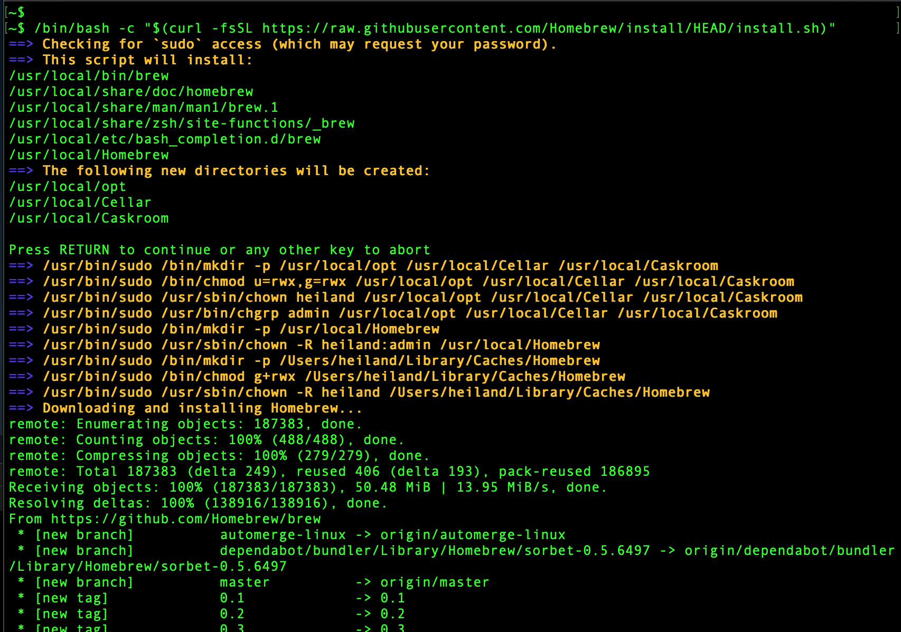
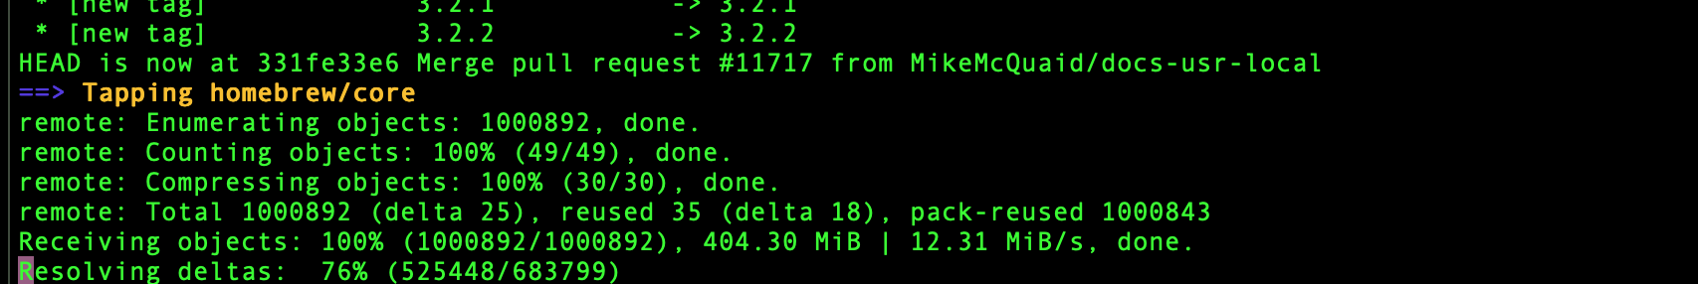
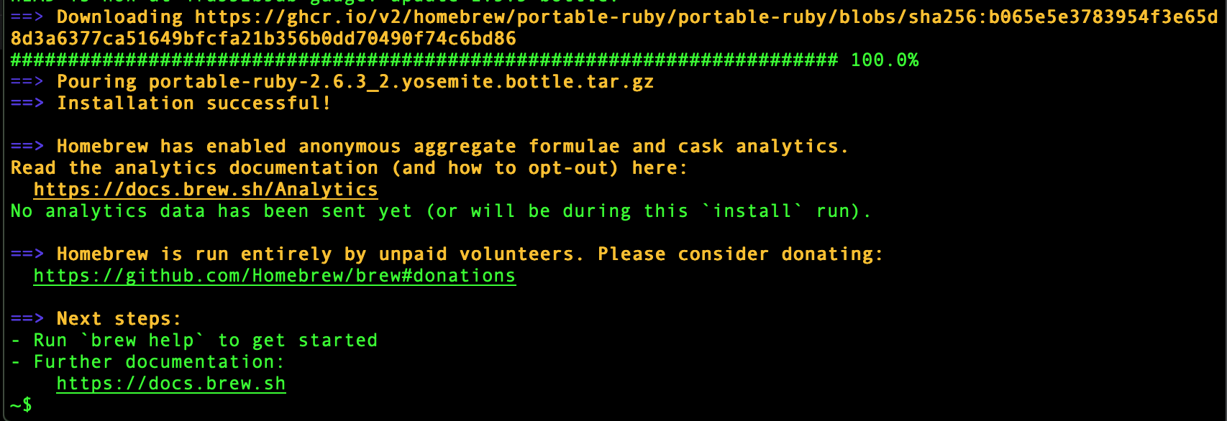
Press ‘return’ to execute the command you copied into the Terminal window. Then ‘return’ again to continue the installation of Homebrew.
Your output should resemble these screenshots.
This will take a few minutes, depending on your network speed.
Continue to next slide →

Slide 6
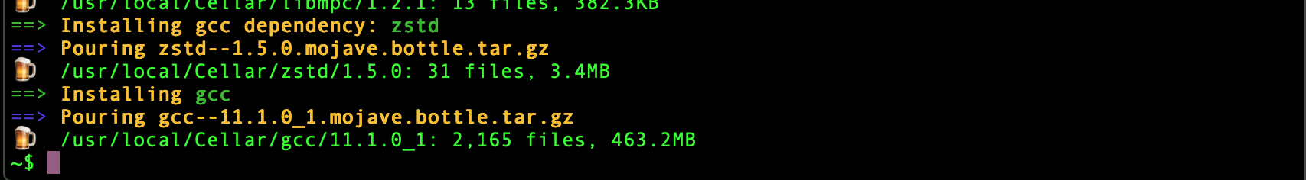
Once you’ve completed installing the basic Homebrew package manager, proceed to install an OpenMP-enabled g++ using the Terminal command:
brew install gcc
Again, this will take a few minutes. It should end with something like this (but with the name of your macOS version instead of “mojave”)
When it completes, run the Terminal command:
ls -l /usr/local/bin/g++*
This will show the newly installed version of g++ that you will use for PhysiCell. Currently (July 2021), it is version 11, i.e., you should see the following:
/usr/local/bin/g++-11@ -> ../Cellar/gcc/11.1.0_1/bin/g++-11
Continue to next slide →

Slide 7
PHYSICELL_CPP
As described in the Quickstart guide: https://github.com/MathCancer/PhysiCell/blob/master/documentation/Quickstart.md#macos
You want to define an environment variable that will point to this g++ so that a PhysiCell Makefile will know to use it:
export PHYSICELL_CPP=/usr/local/bin/g++-11
Furthermore, we recommend that you make this a permanent feature of any new Terminal Shell window that you open. To do this, you want to copy/paste the above export command into a special, existing configuration file. This file will be in your HOME directory (type: echo $HOME) and the name of the config file will depend on the type of shell that you are using – most likely either “bash” or “zsh”. To find out which, run:
echo $SHELL
It should print out either: /bin/bash or /bin/zsh
If you are using “bash”, you should have a .bash_profile file (has a preceding “.”); if “zsh” then a .zshenv file in your home directory. If this file does not exist, you will need to create it. From a Terminal shell do:
cd ~ # go to your home directory
touch .bash_profile # or for zsh, touch .zshenv
https://support.apple.com/guide/terminal/use-environment-variables-apd382cc5fa-4f58-4449-b20a-41c53c006f8f/mac for more about env vars

Slide 8
PHYSICELL_CPP (cont’d)
To permanently put the previous export command into your shell’s configuration file, so that it is executed each time a new shell is opened, run one of the following in your Terminal (again, depending on which shell you are using):
echo export PHYSICELL_CPP=g++-11 >> ~/.bash_profile
or,
echo export PHYSICELL_CPP=g++-11 >> ~/.zshenv
When you open a new Terminal shell, you can verify that this is defined:
echo $PHYSICELL_CPP
You should see this printed out:
g++-11

Slide 9
Overview
Apple Intel CPU vs. Silicon (M1) CPU
You may experience some problems with our setup instructions if you have the newer Apple Silicon CPU. If so, please contact us (see Support page at end).
OpenMP-enabled g++ (using Homebrew)
Test building the default model (“heterogeneity”)
Python 3 (using Anaconda distribution)
Test building an intracellular model
ImageMagick
PhysiCell Model Builder

Slide 10
Test build/run: PhysiCell model (1)
At this point, you should be able to compile and run the default PhysiCell model.
Download the latest release of PhysiCell from: https://github.com/MathCancer/PhysiCell/releases e.g.,
https://github.com/MathCancer/PhysiCell/releases/download/1.9.0/PhysiCell_V.1.9.0.zip
~$ cd ~/Downloads/
~/Downloads$ ls -l PhysiCell_V.1.9.0.zip
-rw-r--r--@ 1 heiland staff 5281228 Jul 15 15:33 PhysiCell_V.1.9.0.zip
~/Downloads$ mv PhysiCell_V.1.9.0.zip ~ # move this .zip file to your home directory
~/Downloads$ cd ~ # change to home directory
~$ unzip -q PhysiCell_V.1.9.0.zip
~$ cd PhysiCell
~/PhysiCell$

Slide 11
Test build/run: PhysiCell model (2)
~/PhysiCell$ make # from this directory, just run ‘make’
→ You will see the following output:
make heterogeneity-sample
cp ./sample_projects/heterogeneity/custom_modules/* ./custom_modules/
touch main.cpp && cp main.cpp main-backup.cpp
cp ./sample_projects/heterogeneity/main-heterogeneity.cpp ./main.cpp
cp Makefile Makefile-backup
cp ./sample_projects/heterogeneity/Makefile .
cp ./config/PhysiCell_settings.xml ./config/PhysiCell_settings-backup.xml
cp ./sample_projects/heterogeneity/config/* ./config/
make
g++-11 -march=native -O3 -fomit-frame-pointer -mfpmath=both -fopenmp -m64 -std=c++11 -c ./BioFVM/BioFVM_vector.cpp
... (continues to compile files)...
g++-11 -march=native -O3 -fomit-frame-pointer -mfpmath=both -fopenmp -m64 -std=c++11 -o heterogeneity BioFVM_vector.o BioFVM_mesh.o BioFVM_microenvironment.o BioFVM_solvers.o BioFVM_matlab.o BioFVM_utilities.o BioFVM_basic_agent.o BioFVM_MultiCellDS.o BioFVM_agent_container.o pugixml.o PhysiCell_phenotype.o PhysiCell_cell_container.o PhysiCell_standard_models.o PhysiCell_cell.o PhysiCell_custom.o PhysiCell_utilities.o PhysiCell_constants.o PhysiCell_basic_signaling.o PhysiCell_SVG.o PhysiCell_pathology.o PhysiCell_MultiCellDS.o PhysiCell_various_outputs.o PhysiCell_pugixml.o PhysiCell_settings.o PhysiCell_geometry.o heterogeneity.o main.cpp
~/PhysiCell$
This is the default model (executable)
that is created.

Slide 12
Test build/run: PhysiCell model (3)
~/PhysiCell$ ./heterogeneity # run the model
... → lots of model configuration info will be printed out, and then info at each specified output interval:
Oncoprotein summary:
===================
mean: 1.00687
standard deviation: 0.250737
[min max]: [0.205535 1.71906]
Using PhysiCell version 1.9.0
Please cite DOI: 10.1371/journal.pcbi.1005991
Project website: http://PhysiCell.MathCancer.org
See ALL_CITATIONS.txt for this list.
current simulated time: 0 min (max: 64800 min)
total agents: 890
interval wall time: 0 days, 0 hours, 0 minutes, and 2.1e-05 seconds
total wall time: 0 days, 0 hours, 0 minutes, and 2.4e-05 seconds
Using method diffusion_decay_solver__constant_coefficients_LOD_2D (2D LOD with Thomas Algorithm) ...
current simulated time: 60 min (max: 64800 min)
total agents: 896
interval wall time: 0 days, 0 hours, 0 minutes, and 1.89867 seconds
total wall time: 0 days, 0 hours, 0 minutes, and 1.8987 seconds

Slide 13
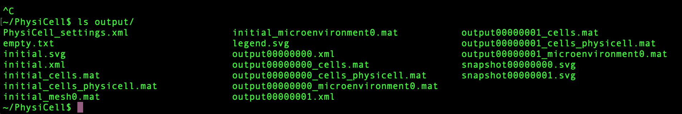
Test build/run: PhysiCell model (4)
current simulated time: 60 min (max: 64800 min)
total agents: 896
interval wall time: 0 days, 0 hours, 0 minutes, and 1.89867 seconds
total wall time: 0 days, 0 hours, 0 minutes, and 1.8987 seconds
You can press “control-c” to cancel the simulation and then type: ls output # list files created in the /output directory

Slide 14
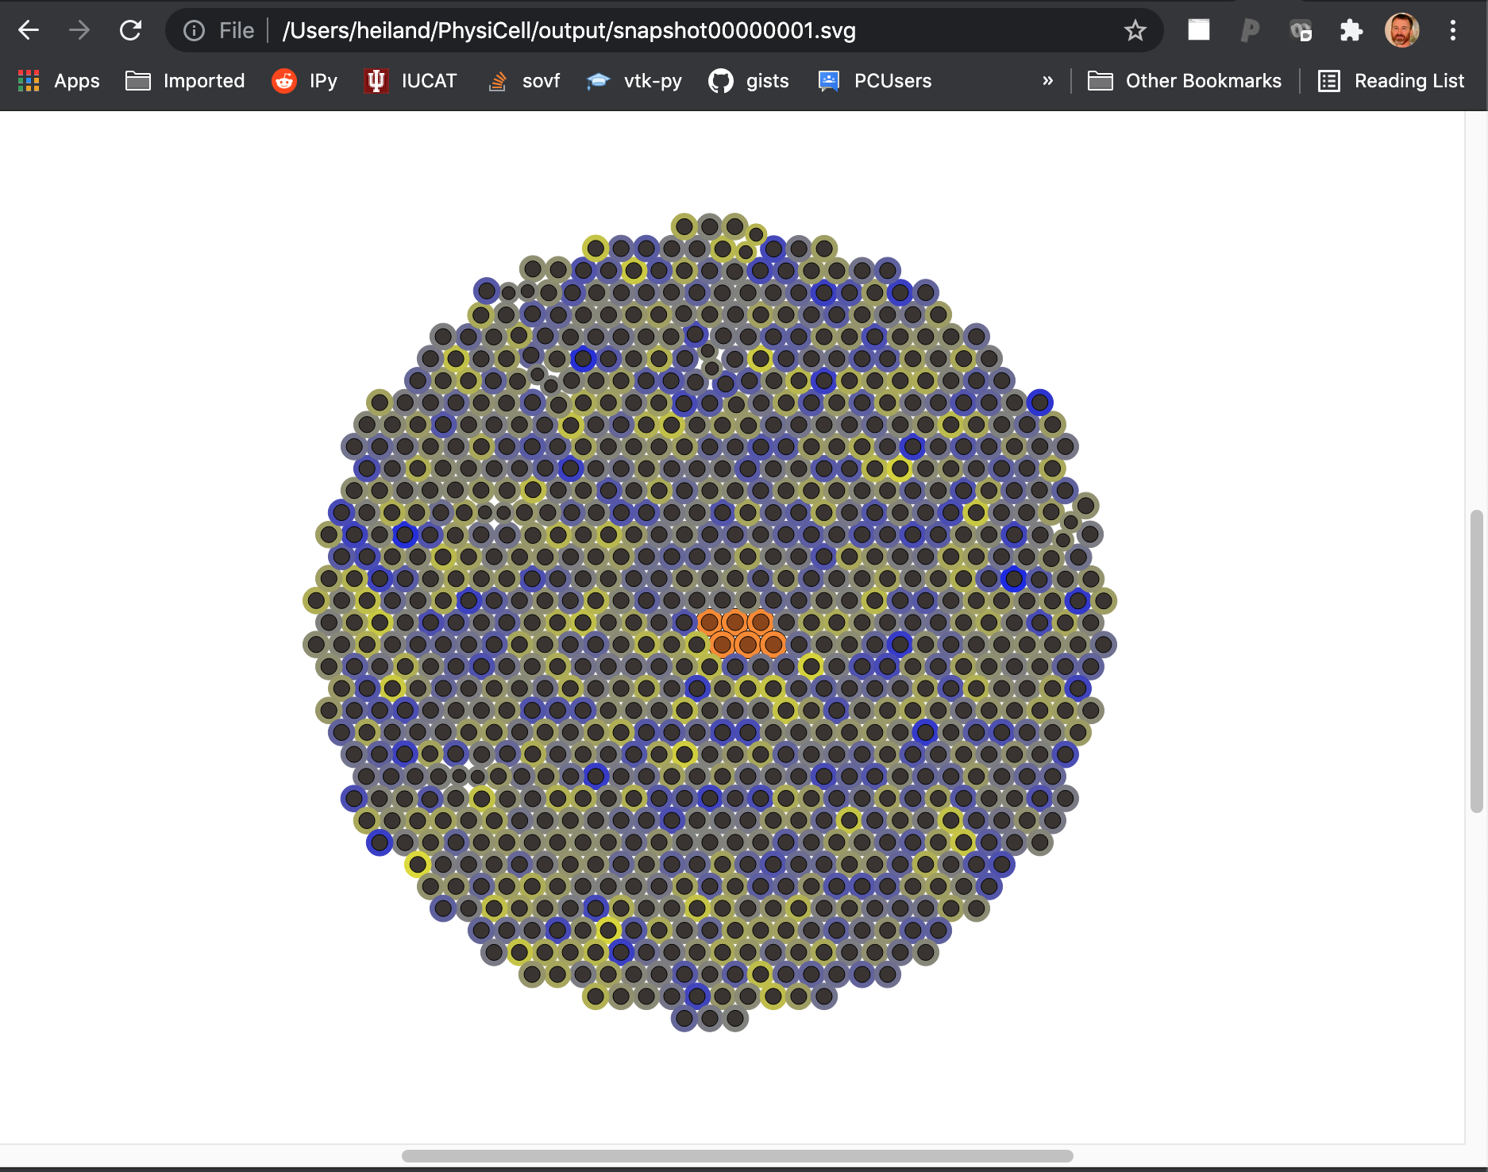
Test build/run: PhysiCell model (5)
To easily visualize the cells at a particular output interval, you can simply open one of the .svg files in your Web browser. Beware that it will be rather large, but you can use the scrollbars to find the heterogeneous tumor of cells at the center of the domain.

Slide 15
Overview
Apple Intel CPU vs. Silicon (M1) CPU
You may experience some problems with our setup instructions if you have the newer Apple Silicon CPU. If so, please contact us (see Support page at end).
OpenMP-enabled g++ (using Homebrew)
Test building the default model (“heterogeneity”)
Python 3 (using Anaconda distribution)
Test building an intracellular model
ImageMagick
PhysiCell Model Builder
Git (optional)

Slide 16
Python
Python is a requirement for certain aspects of PhysiCell:
It is needed to install certain libraries for the intracellular models.
It can be used for visualization and data analysis scripts.
It is used for Jupyter notebook apps of PhysiCell models.
It can be used for parameter explorations of models.

Slide 17
Python 3 (not Python 2)
Note that your Mac probably has a Python 2 installed, by default:
~$ which python
/usr/bin/python
~$ python
Python 2.7.16 (default, Jan 27 2020, 04:46:15)
[GCC 4.2.1 Compatible Apple LLVM 10.0.1 (clang-1001.0.37.14)] on darwin
Type "help", "copyright", "credits" or "license" for more information.
>>>
We want Python 3. (And even if the newer Macs come bundled with Python 3, it will not contain all the modules that we want).

Slide 18
Anaconda Python 3.x
Download a (free) Python distribution that comes bundled with lots of useful modules that are not in the standard Python library.
https://www.anaconda.com/products/individual#Downloads
https://docs.anaconda.com/anaconda/install/mac-os/
First, we illustrate using the “64-Bit Command Line Installer” (later, the Graphical installer)
~/Downloads$ /bin/bash Anaconda3-2021.05-MacOSX-x86_64.sh
Welcome to Anaconda3 2021.05
In order to continue the installation process, please review the license
agreement.
Please, press ENTER to continue
>>>

Slide 19
Anaconda Python 3.x
Please, press ENTER to continue
>>>
... (keep pressing ‘enter’)...
Do you accept the license terms? [yes|no]
[no] >>> yes
Anaconda3 will now be installed into this location:
/Users/heiland/anaconda3
- Press ENTER to confirm the location
- Press CTRL-C to abort the installation
- Or specify a different location below
[/Users/heiland/anaconda3] >>> (just press Enter to confirm the default location, then wait a few mins for installation...)
PREFIX=/Users/heiland/anaconda3
Unpacking payload ...

Slide 20
Anaconda Python 3.x
...
Preparing transaction: done
Executing transaction: /
done
installation finished.
WARNING:
You currently have a PYTHONPATH environment variable set. This may cause
unexpected behavior when running the Python interpreter in Anaconda3.
For best results, please verify that your PYTHONPATH only points to
directories of packages that are compatible with the Python interpreter
in Anaconda3: /Users/heiland/anaconda3
Do you wish the installer to initialize Anaconda3
by running conda init? [yes|no]
[yes] >>> (just press ‘enter’ to continue)
It’s OK if you see this warning. You can disregard it for now.

Slide 21
Anaconda Python 3.x
...
Do you wish the installer to initialize Anaconda3
by running conda init? [yes|no]
[yes] >>> (just press ‘enter’ to continue)
...
==> For changes to take effect, close and re-open your current shell. <==
If you'd prefer that conda's base environment not be activated on startup,
set the auto_activate_base parameter to false:
conda config --set auto_activate_base false
Thank you for installing Anaconda3!
===========================================================================
Working with Python and Jupyter notebooks is a breeze with PyCharm Pro,
designed to be used with Anaconda. Download now and have the best data
tools at your fingertips.
PyCharm Pro for Anaconda is available at: https://www.anaconda.com/pycharm
This means you!!! The base python environment you just installed won’t load until you RESTART your shell.
A simple way to do this is close your current Terminal session and restart it. Or to open a new Terminal window.

Slide 22
Anaconda Python 3.x
After installation is complete, verify that “python” points to the Anaconda version:
~/Downloads$ which python
/Users/heiland/anaconda3/bin/python

Slide 23
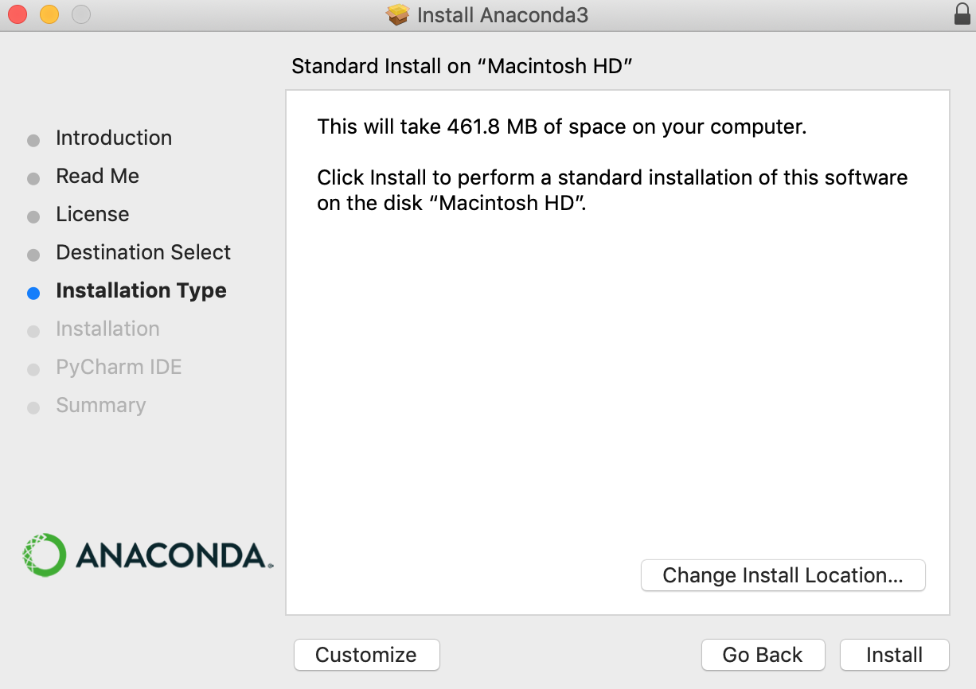
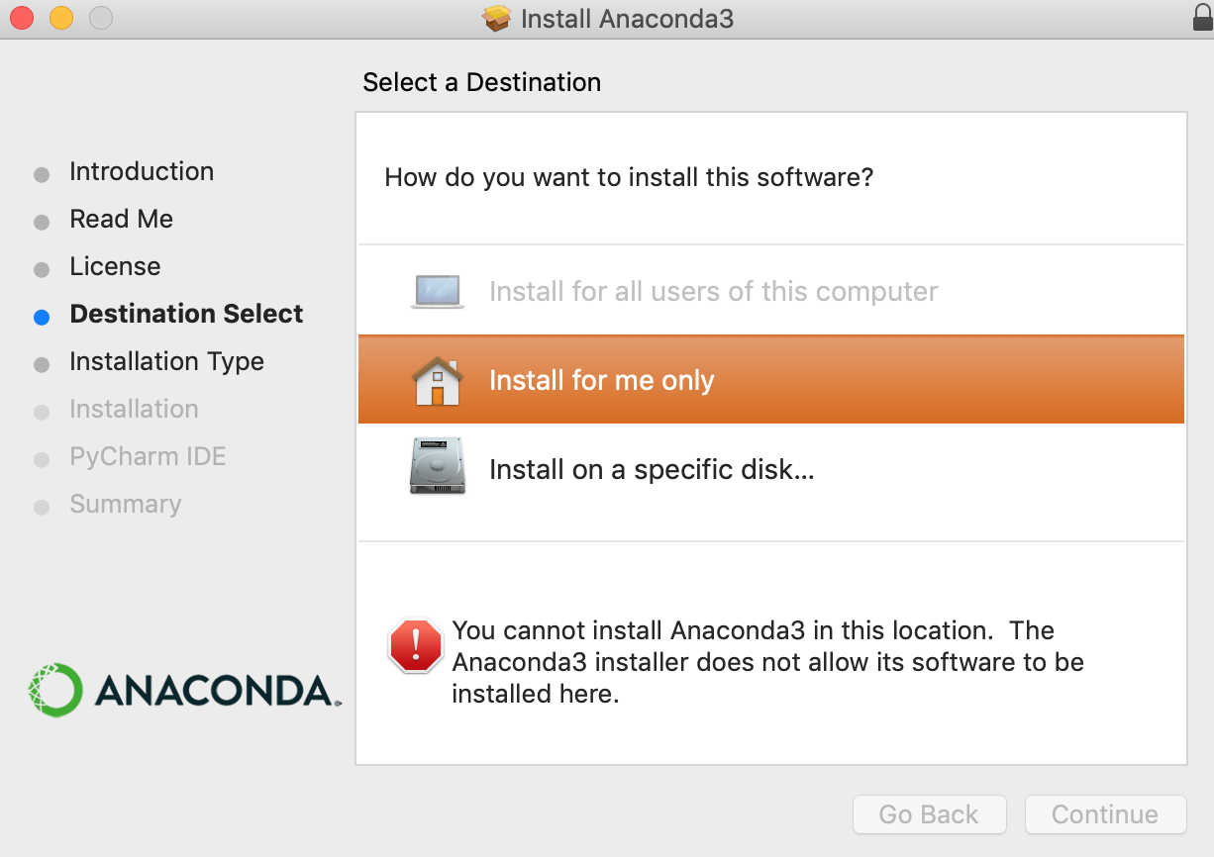
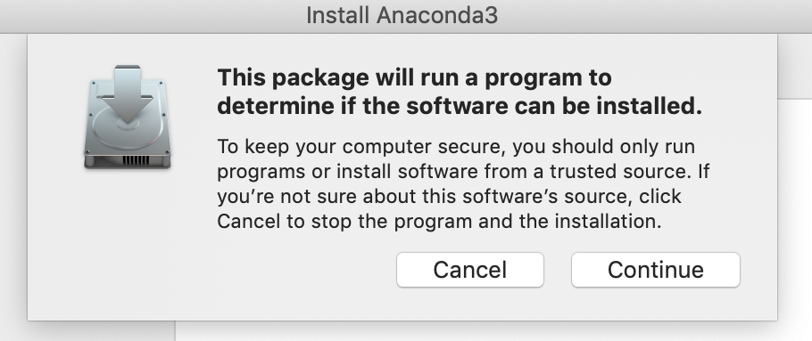
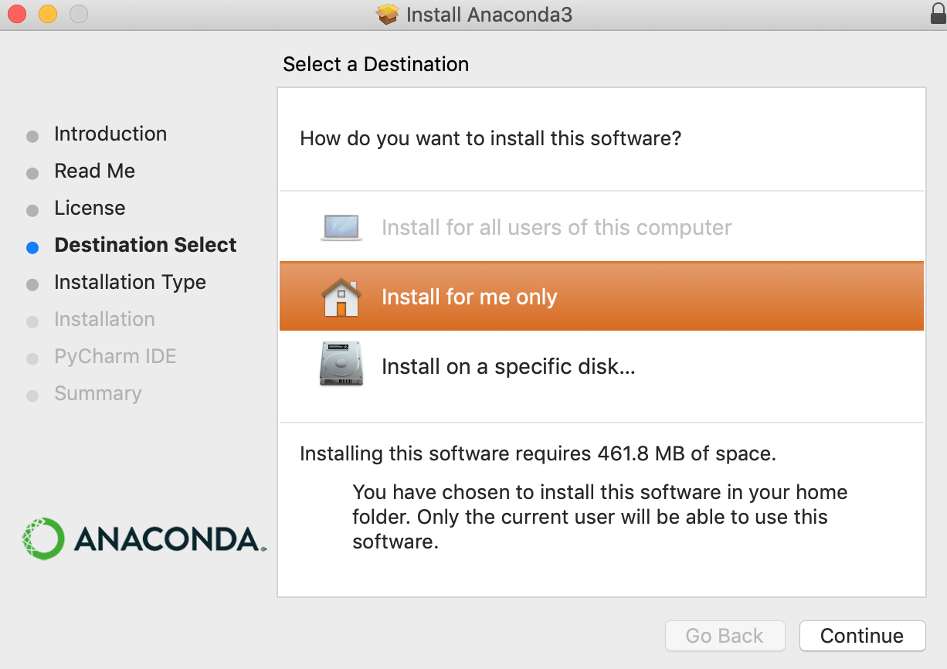
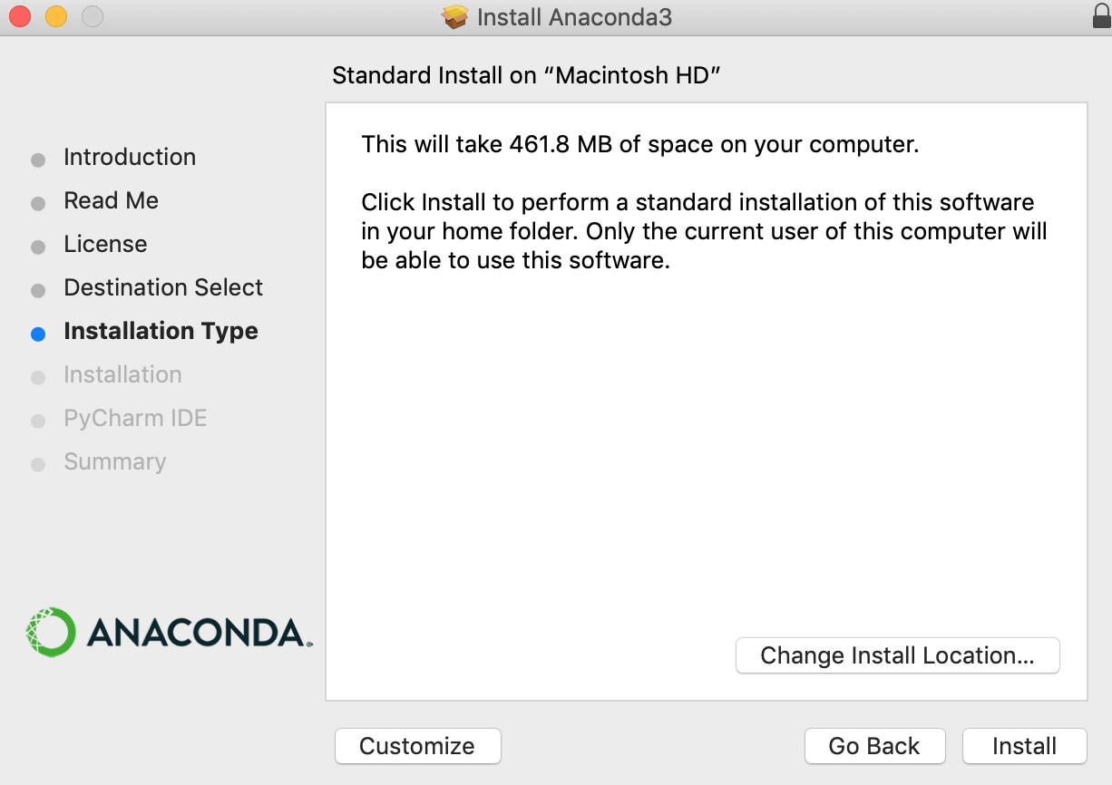
Anaconda Graphical Installer
~$ open Anaconda3-2021.05-MacOSX-x86_64.pkg
2
3
Click
1
Click to install only for you
Keep clicking ‘Continue’ and agree to their license.
4
5
Click ‘Install’

Slide 24
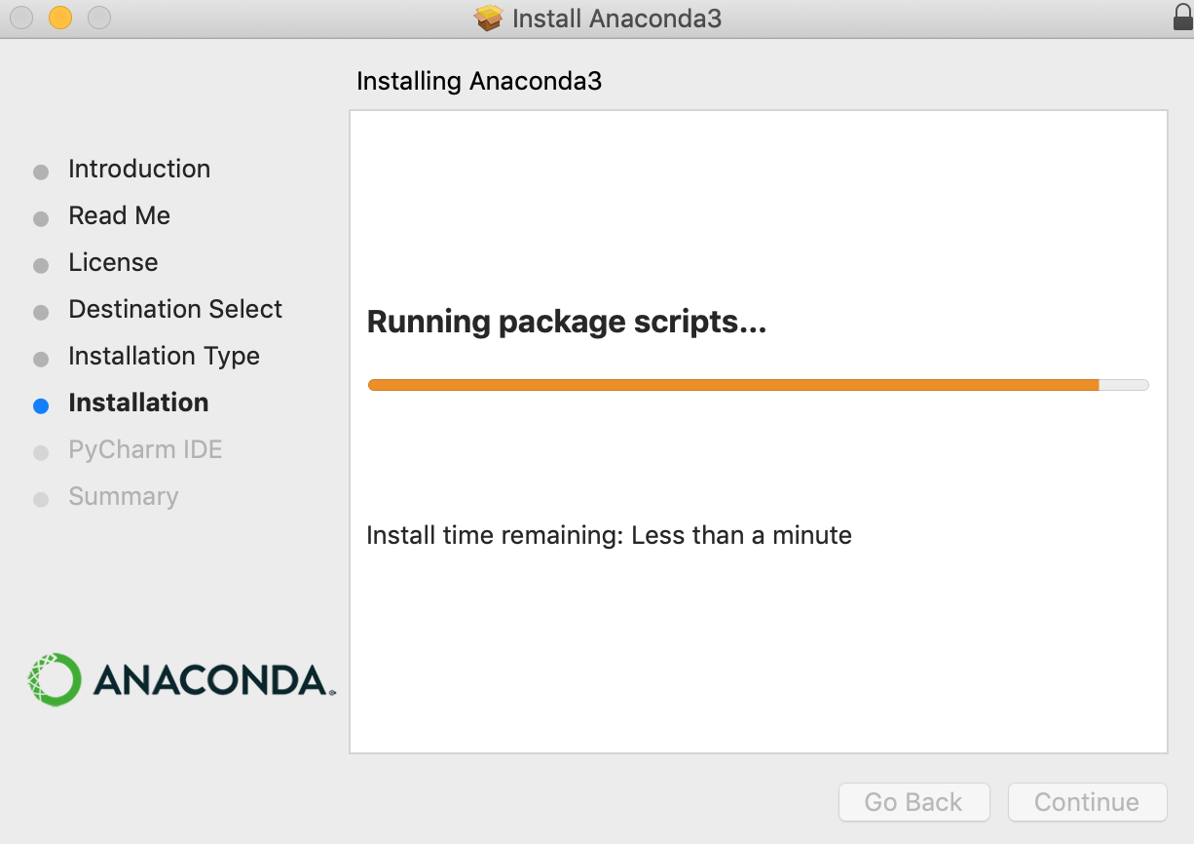
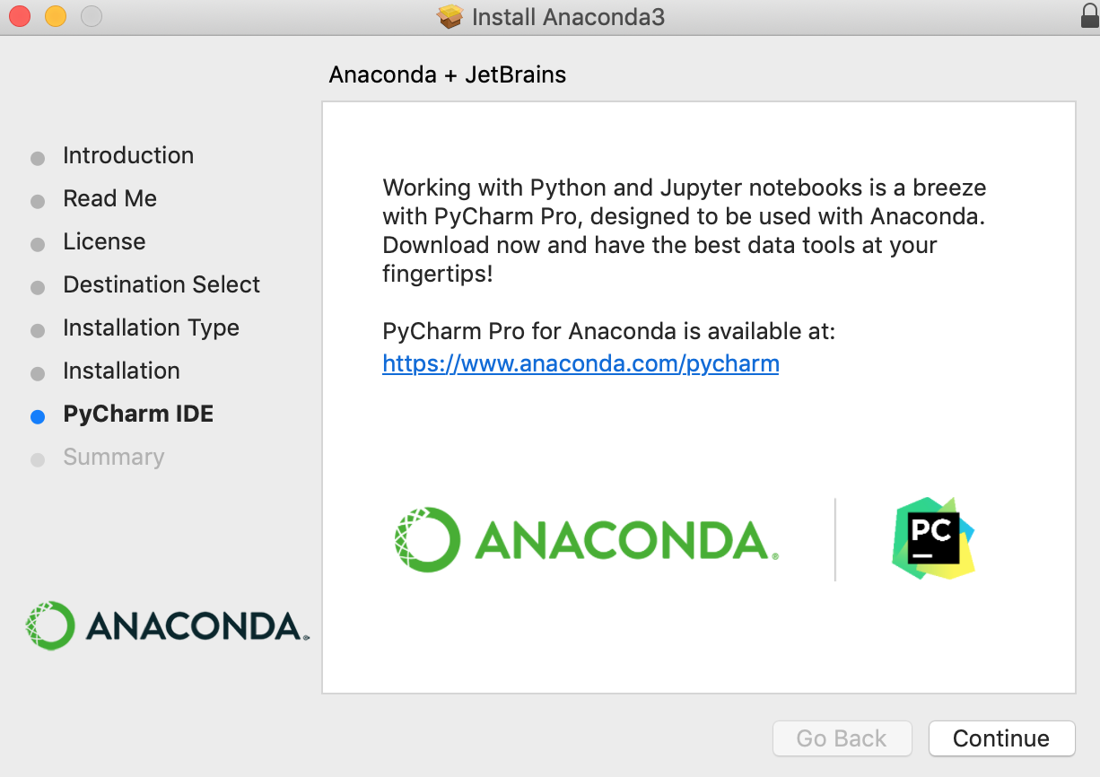
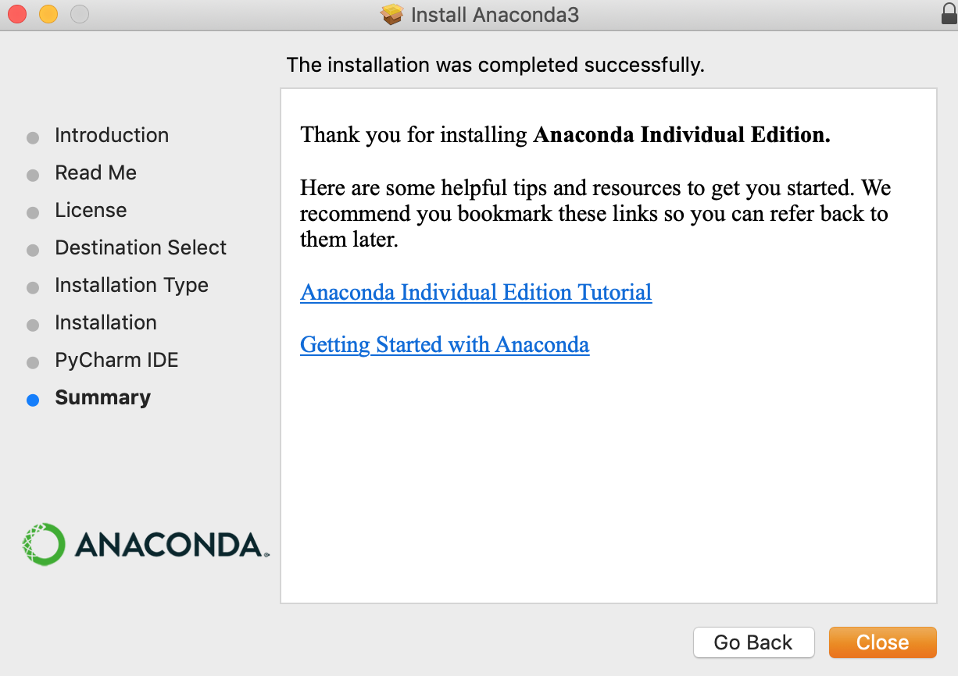
6
7
You can decide, but we won’t use it.
Probably takes longer than a minute
8
Open a New Terminal shell to verify you are using the Anaconda Python as your default:
~$ which python
/Users/heiland/opt/anaconda3/bin/python
Close

Slide 25
Overview
Apple Intel CPU vs. Silicon (M1) CPU
You may experience some problems with our setup instructions if you have the newer Apple Silicon CPU. If so, please contact us (see Support page at end).
OpenMP-enabled g++ (using Homebrew)
Test building the default model (“heterogeneity”)
Python 3 (using Anaconda distribution)
Test building an intracellular model
ImageMagick
PhysiCell Model Builder

Slide 26
Intracellular sample project (uses Python 3 to install a lib)
~/PhysiCell$ make reset
rm -f *.cpp
cp ./sample_projects/Makefile-default Makefile
rm -f ./custom_modules/*
touch ./custom_modules/empty.txt
touch ALL_CITATIONS.txt
touch ./core/PhysiCell_cell.cpp
rm ALL_CITATIONS.txt
cp ./config/PhysiCell_settings-backup.xml ./config/PhysiCell_settings.xml
touch ./config/empty.csv
rm -f ./config/*.csv
~/PhysiCell$ make list-projects
Sample projects: template biorobots-sample cancer-biorobots-sample cancer-immune-sample
celltypes3-sample heterogeneity-sample pred-prey-farmer virus-macrophage-sample worm-sample
Sample intracellular projects: ode-energy-sample physiboss-cell-lines-sample cancer-metabolism-sample
~/PhysiCell$

Slide 27
ODE intracellular model (1)
~/PhysiCell$ make ode-energy-sample
cp ./sample_projects_intracellular/ode/ode_energy/custom_modules/* ./custom_modules/
touch main.cpp && cp main.cpp main-backup.cpp
cp ./sample_projects_intracellular/ode/ode_energy/main.cpp ./main.cpp
cp Makefile Makefile-backup
cp ./sample_projects_intracellular/ode/ode_energy/Makefile .
cp ./config/PhysiCell_settings.xml ./config/PhysiCell_settings-backup.xml
cp ./sample_projects_intracellular/ode/ode_energy/config/* ./config/
~/PhysiCell$ make
python3 beta/setup_libroadrunner.py
This model requires the libRoadrunner libraries which will now be downloaded.
(for your Darwin operating system)
libRoadRunner will now be installed into this location:
addons/libRoadrunner
Beginning download of libroadrunner into addons/libRoadrunner ...
https://sourceforge.net/projects/libroadrunner/files/libroadrunner-1.4.18/roadrunner-osx-10.9-cp36m.tar.gz/download
my_file = addons/libRoadrunner/roadrunner-osx-10.9-cp36m.tar.gz
rrlib_dir = addons/libRoadrunner/roadrunner-osx-10.9-cp36m
100.0% 96092160 / 96087190
installing (uncompressing) the file...
Done.
The ODE solver library is downloaded

Slide 28
ODE intracellular model (2)
(from previous ‘make’)
g++-11 -march=native -O3 -fomit-frame-pointer -fopenmp -m64 -std=c++11 -D ADDON_ROADRUNNER -I./addons/libRoadrunner/roadrunner/include/rr/C -c ./core/PhysiCell_cell.cpp
g++-11 -march=native -O3 -fomit-frame-pointer -fopenmp -m64 -std=c++11 -D ADDON_ROADRUNNER -I./addons/libRoadrunner/roadrunner/include/rr/C -c ./custom_modules/custom.cpp
g++-11 -march=native -O3 -fomit-frame-pointer -fopenmp -m64 -std=c++11 -D ADDON_ROADRUNNER -I./addons/libRoadrunner/roadrunner/include/rr/C -c ./addons/libRoadrunner/src/librr_intracellular.cpp
Your OS= -D OSX
LIBRR_CFLAGS= -I./addons/libRoadrunner/roadrunner/include/rr/C
LIBRR_LIBS= ./addons/libRoadrunner/roadrunner/lib
g++-11 -march=native -O3 -fomit-frame-pointer -fopenmp -m64 -std=c++11 -D ADDON_ROADRUNNER -I./addons/libRoadrunner/roadrunner/include/rr/C -o ode_energy BioFVM_vector.o BioFVM_mesh.o BioFVM_microenvironment.o BioFVM_solvers.o BioFVM_matlab.o BioFVM_utilities.o BioFVM_basic_agent.o BioFVM_MultiCellDS.o BioFVM_agent_container.o pugixml.o PhysiCell_phenotype.o PhysiCell_cell_container.o PhysiCell_standard_models.o PhysiCell_cell.o PhysiCell_custom.o PhysiCell_utilities.o PhysiCell_constants.o PhysiCell_SVG.o PhysiCell_pathology.o PhysiCell_MultiCellDS.o PhysiCell_various_outputs.o PhysiCell_pugixml.o PhysiCell_settings.o custom.o librr_intracellular.o main.cpp -L./addons/libRoadrunner/roadrunner/lib -lroadrunner_c_api
created ode_energy
~/PhysiCell$ ./ode_energy
dyld: Library not loaded: @rpath/libroadrunner_c_api.dylib
Referenced from: /Users/heiland/PhysiCell/./ode_energy
Reason: image not found
Abort trap: 6
~/PhysiCell$
You will see this output (but not highlighted … ) if the executable was successfully made
When we try to run the model, we get an error, but it was expected and serves as a reminder if/when you ever see it again. See next slide.

Slide 29
ODE intracellular model (3)
~/PhysiCell$ export DYLD_LIBRARY_PATH=$DYLD_LIBRARY_PATH:./addons/libRoadrunner/roadrunner/lib
~/PhysiCell$ ./ode_energy
... model info output...
current simulated time: 30 min (max: 1440 min)
total agents: 144
interval wall time: 0 days, 0 hours, 0 minutes, and 4.27858 seconds
total wall time: 0 days, 0 hours, 0 minutes, and 4.27861 seconds
current simulated time: 60 min (max: 1440 min)
total agents: 144
interval wall time: 0 days, 0 hours, 0 minutes, and 4.33063 seconds
total wall time: 0 days, 0 hours, 0 minutes, and 8.60924 seconds
------------ start: librr_intracellular.cpp: start() called
... (lots more output)...
To avoid the previous runtime error, define another environment variable. The model should then run OK.
And once again, you could use your browser to open one of the .svg files that are created in /output

Slide 30
ODE intracellular model (4)
As before, permanently put this environment variable in your (bash or zsh) shell’s config startup file:
export DYLD_LIBRARY_PATH=$DYLD_LIBRARY_PATH:./addons/libRoadrunner/roadrunner/lib >> ~/.bash_profile
or,
export DYLD_LIBRARY_PATH=$DYLD_LIBRARY_PATH:./addons/libRoadrunner/roadrunner/lib >> ~/.zshenv
Then when you start a new Terminal Shell window, this environment variable will be defined.

Slide 31
Overview
Apple Intel CPU vs. Silicon (M1) CPU
You may experience some problems with our setup instructions if you have the newer Apple Silicon CPU. If so, please contact us (see Support page at end).
OpenMP-enabled g++ (using Homebrew)
Test building the default model (“heterogeneity”)
Python 3 (using Anaconda distribution)
Test building an intracellular model
ImageMagick
PhysiCell Model Builder

Slide 32
ImageMagick (1)
https://imagemagick.org/ - free, powerful image conversion, composition, editing software.
$ brew install imagemagick
(probably will install lots of dependencies)
...
==> Installing imagemagick dependency: openexr
==> Pouring openexr--3.0.5.mojave.bottle.tar.gz
🍺 /usr/local/Cellar/openexr/3.0.5: 176 files, 5.0MB
==> Installing imagemagick dependency: webp
==> Pouring webp--1.2.0.mojave.bottle.tar.gz
🍺 /usr/local/Cellar/webp/1.2.0: 39 files, 2.1MB
==> Installing imagemagick
==> Pouring imagemagick--7.1.0-2_1.mojave.bottle.tar.gz
🍺 /usr/local/Cellar/imagemagick/7.1.0-2_1: 799 files, 25MB
You should then have access to various ImageMagick commands, for example:
$ which convert
/usr/local/bin/convert

Slide 33
ImageMagick (2)
Refer to the Quickstart guide for helpful ImageMagick commands, including Makefile targets: https://github.com/MathCancer/PhysiCell/blob/master/documentation/Quickstart.md#imagemagick
For example, if you have generated some .svg files (in /output), you should be able to generate an animation, using something like the following set of commands in your shell:
convert snapshot000034*.svg foo.gif
magick animate foo.gif # may be huge, if original SVGs were; downsize in following steps
convert foo.gif -coalesce tmp.gif
identify snapshot00003471.svg # get size of a single image (e.g. 1500x1605)
convert -size 1500x1605 tmp.gif -resize 20% small.gif
magick animate small.gif

Slide 34
Overview
Apple Intel CPU vs. Silicon (M1) CPU
You may experience some problems with our setup instructions if you have the newer Apple Silicon CPU. If so, please contact us (see Support page at end).
OpenMP-enabled g++ (using Homebrew)
Test building the default model (“heterogeneity”)
Python 3 (using Anaconda distribution)
Test building an intracellular model
ImageMagick
PhysiCell Model Builder

Slide 35
PhysiCell Model Builder (1)
The Model Builder is a GUI to let you create/edit a .xml configuration file that defines (nearly all of) a PhysiCell model.
Download the latest release at:
https://github.com/PhysiCell-Tools/PhysiCell-model-builder/releases
Uncompress the .zip, change directory into it, and run it:
This should display the GUI (next page):
$ unzip PhysiCell-model-builder-1.1.zip
$ cd PhysiCell-model-builder-1.1
$ python bin/gui4xml.py

Slide 36
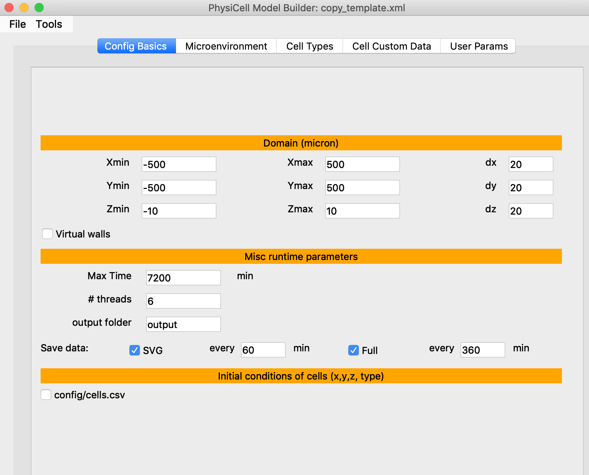
PhysiCell Model Builder (2)
A User Guide for the Model Builder is still be written.
It is a tool that is still considered “beta”, so your feedback will be very valuable.

Slide 37
SBML editors: COPASI (1)
COPASI, SBML, and SBML editors:
COPASI can simulate some categories of mathematical models (ordinary and stochastic differential equations) among other features
COPASI Provides a graphical interface for editing Systems Biology Markup Language (SBML)
SBML is a language used to encode biological models, often intracellular models
The ode-sample-model is written in SBML as is the FBA example
To note it, there are other SBML editors (search “SBML editors” for other options)
For the 2021 PhysiCell workshop, SBML model creation and editing will be demonstrated with COPASI

Slide 38
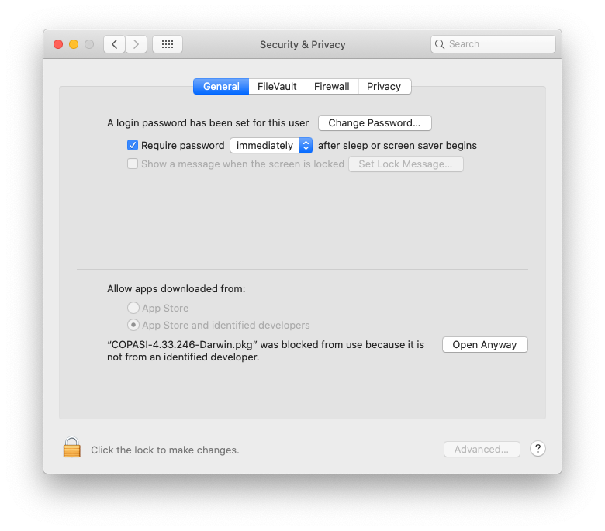
SBML editors: COPASI (2)
Navigate to http://copasi.org/Download/ and download COPASI for Mac OS X
Follow instructions here: http://copasi.org/Support/Installation/Mac_OS_X/
Once downloaded and activated, you may be challenged by Apple security as this app isn’t from the App Store
To get around this:
Go to Settings → Security & Privacy, then the General tab in Security & Privacy
If you recently ran the package file, there will be something like “ “COPASI” was blocked from use because it is not from an identified developer.” and an option “Open Anyway” → Click “Open Anyway”
Complete installation via the COPASI Installer
It should be fine to accept the defaults…
Click here to allow the installer to run

Slide 39
C++ Code editor
When you get to the point of editing the custom C++ code for your model, you will want a decent code editor. If you’re already using one (for C or C++), great! - keep using it. But if you are new to programming, we recommend keeping it pretty simple. If you just search “C++ code editor macOS”, you’ll find some good suggestions.
One popular, free integrated development environment (IDE) that can be used in a minimal fashion for editing is VSCode (https://code.visualstudio.com/).

Slide 40
Version control
When you get to the point of editing the custom C++ code, python scripts for analysis, etc, it is common to use version control for your code and to share with collaborators. If you are already using version control great! - keep using it. If you are new to programming, we recommend using git. A search for “git mac install” will yield helpful results. (You may even already have it – it is included in XCode command line tools).
Once you have git, github.com is a common place to share code. There are also many graphical interfaces for git (GitHub has one for example.)

Slide 41
Support
We encourage you to join and actively use the PhysiCell community Slack channel. There, you can post questions (#troubleshooting), answer questions, and (hopefully) share successful modeling stories.
Alternatively, you can submit problem tickets at https://sourceforge.net/p/physicell/tickets/
Finally, please follow us on Twitter @PhysiCell and @MathCancer.

Slide 42




Funding Acknowledgements
PhysiCell Development:
Breast Cancer Research Foundation
Jayne Koskinas Ted Giovanis Foundation for Health and Policy
National Cancer Institute (U01CA232137)
National Science Foundation (1720625)
Training Materials:
Administrative supplement to NCI U01CA232137 (Year 2)

